Slide 1

Olympic Games

Slide 2

Question
Do height and age effect on whether an athlete earns a medal?

Slide 3
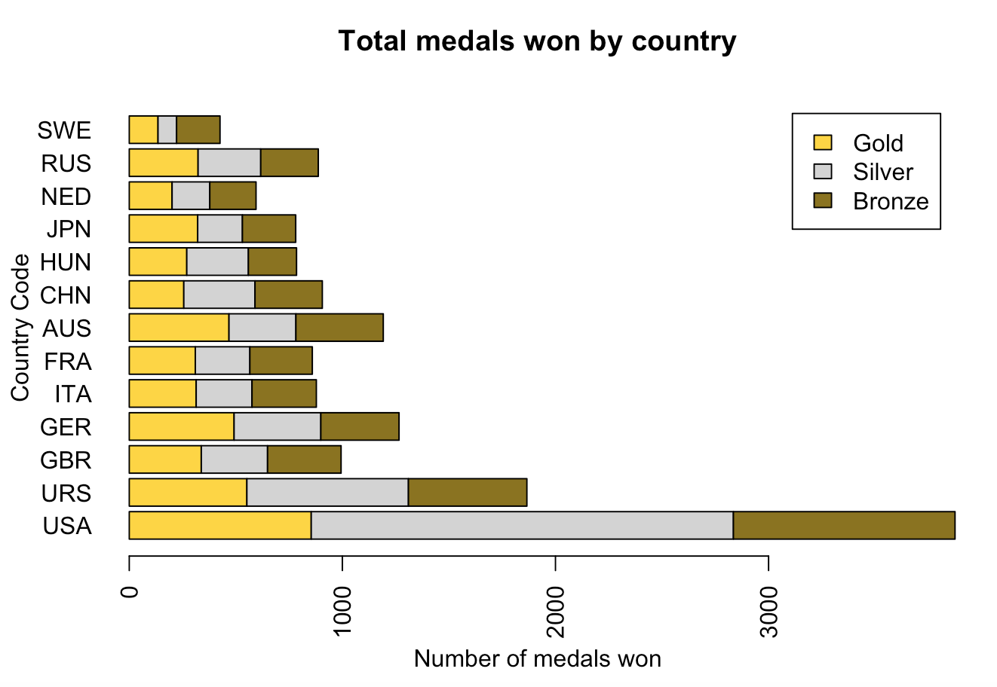
Medals

Slide 4
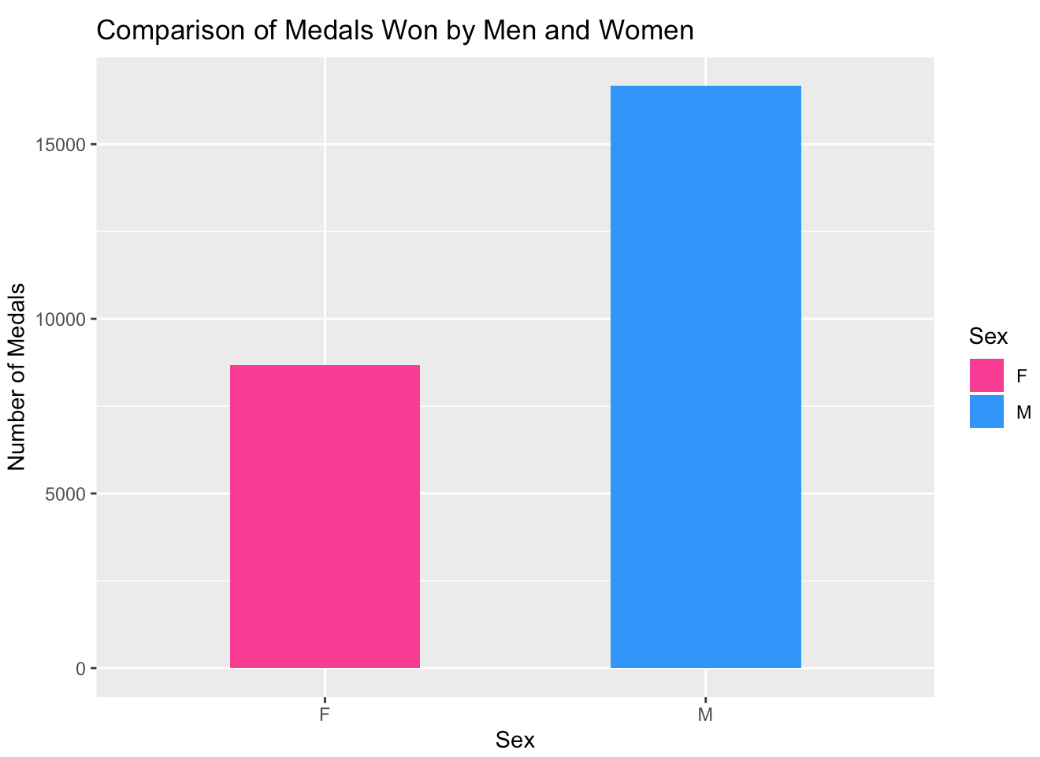
Medals

Slide 5
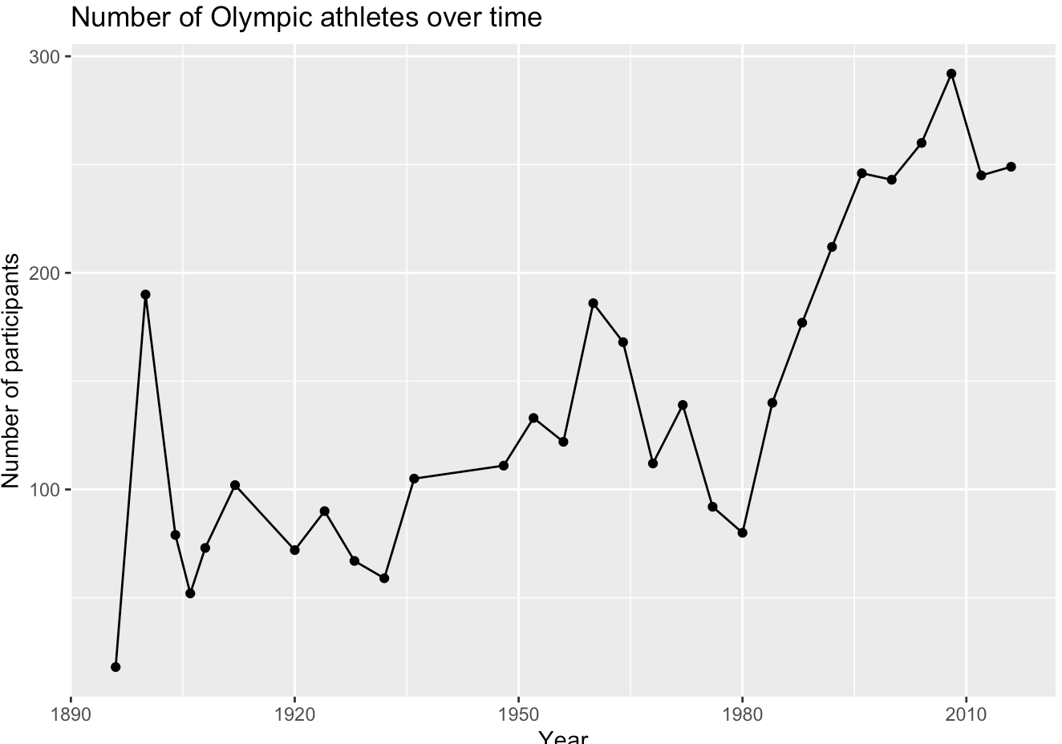
Participation by Year

Slide 6
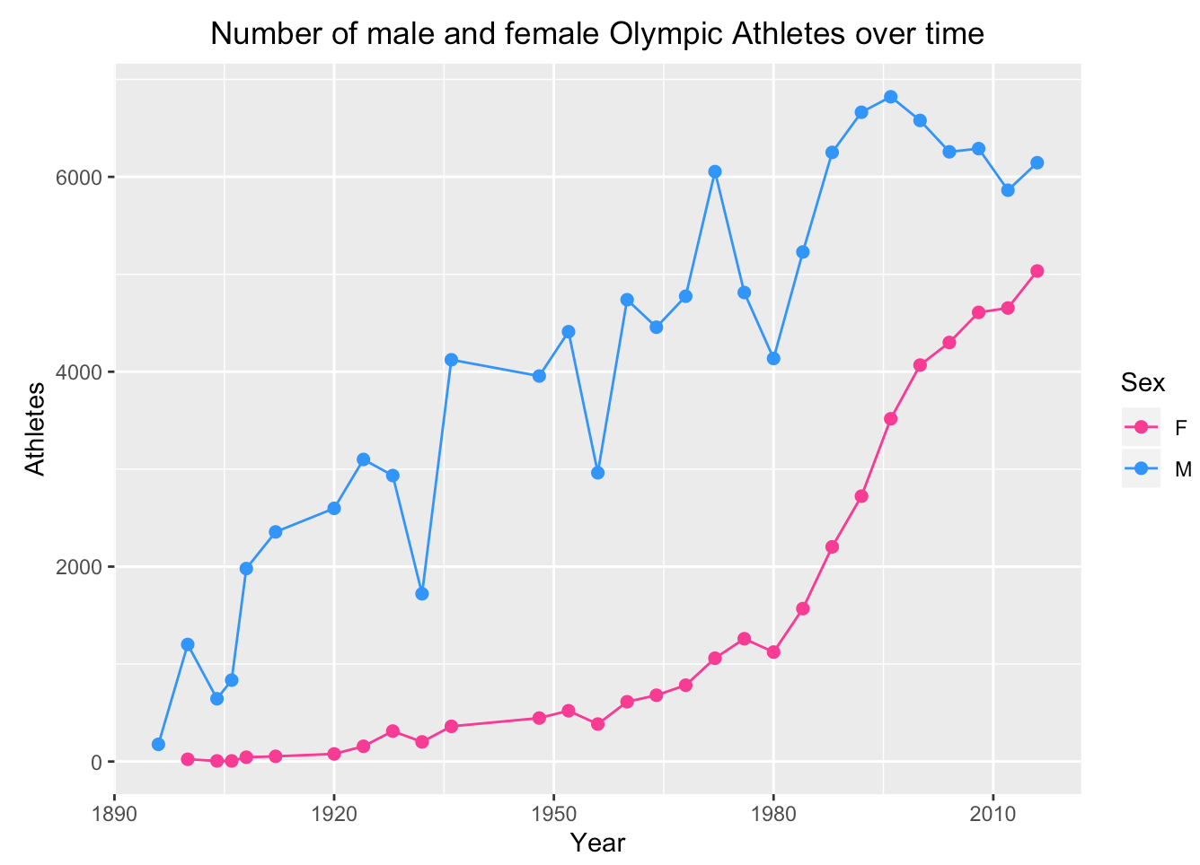
Participation by Female vs Male

Slide 7
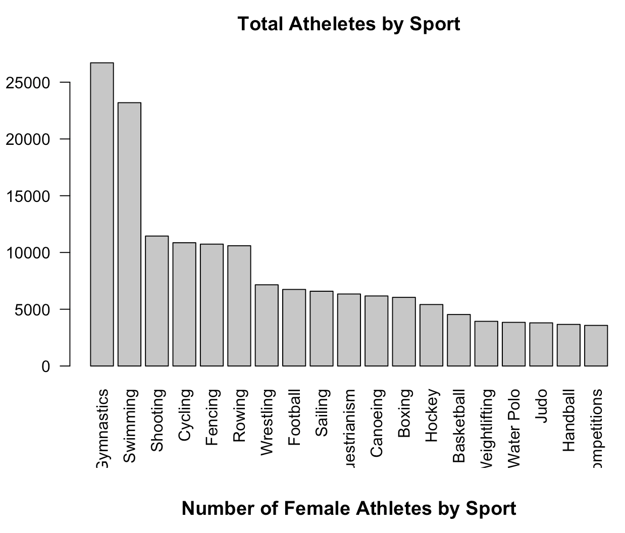
Participation by Sport

Slide 8
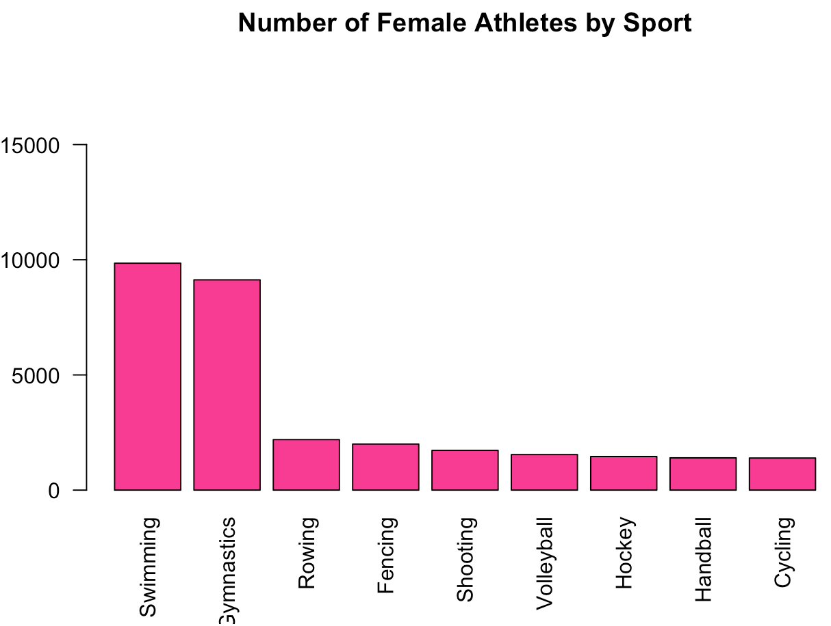
Number of Female Athletes by Sport

Slide 9
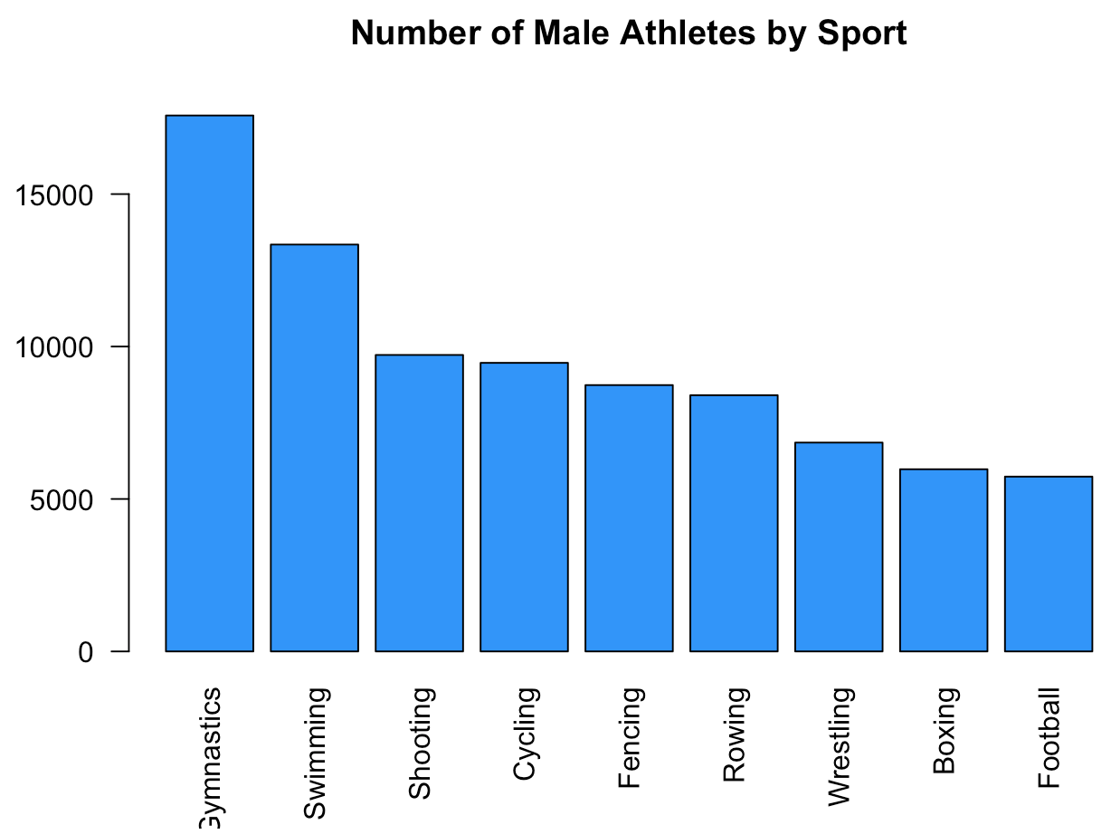
Number of Male Athletes by Sport

Slide 10
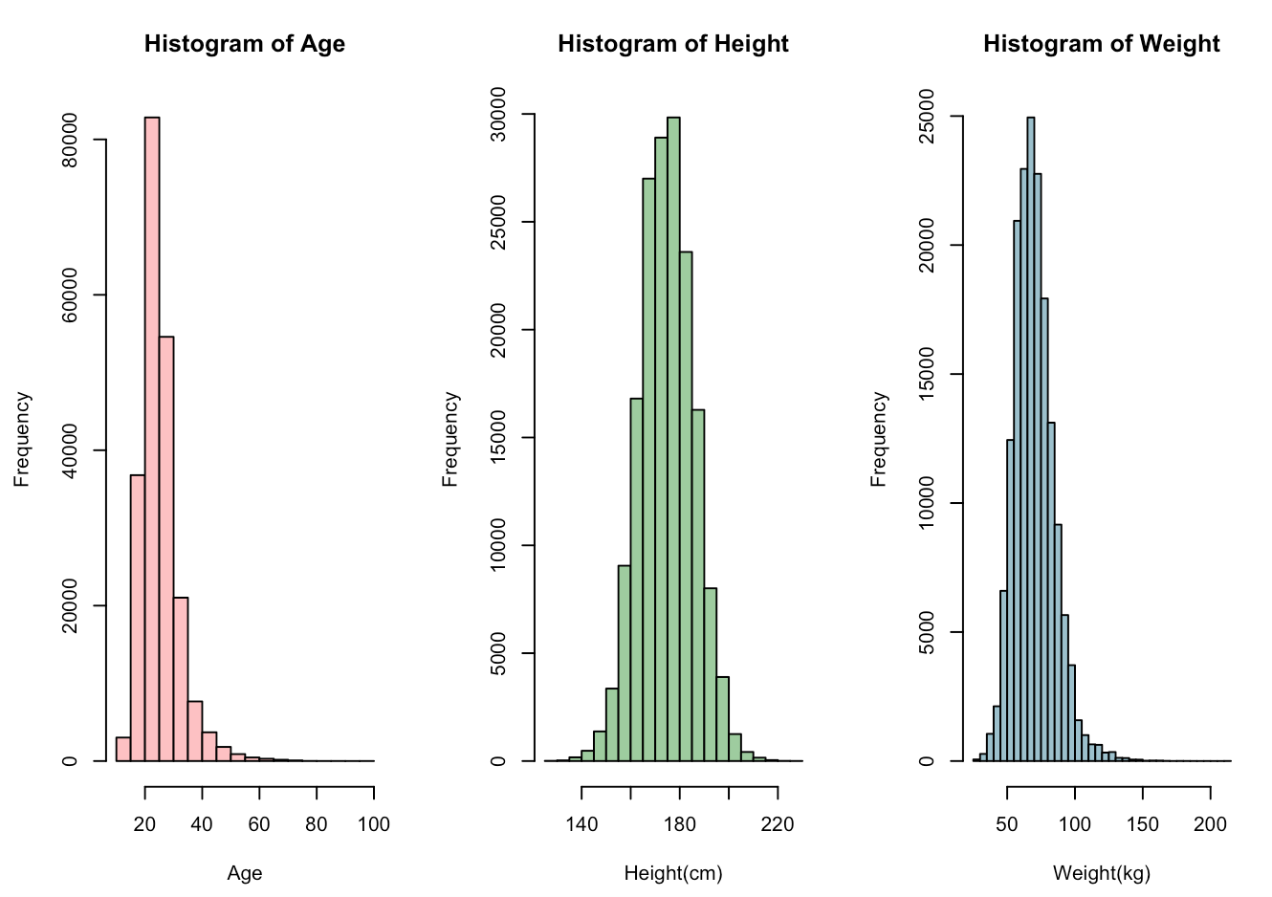
Age, Height, Weight

Slide 11
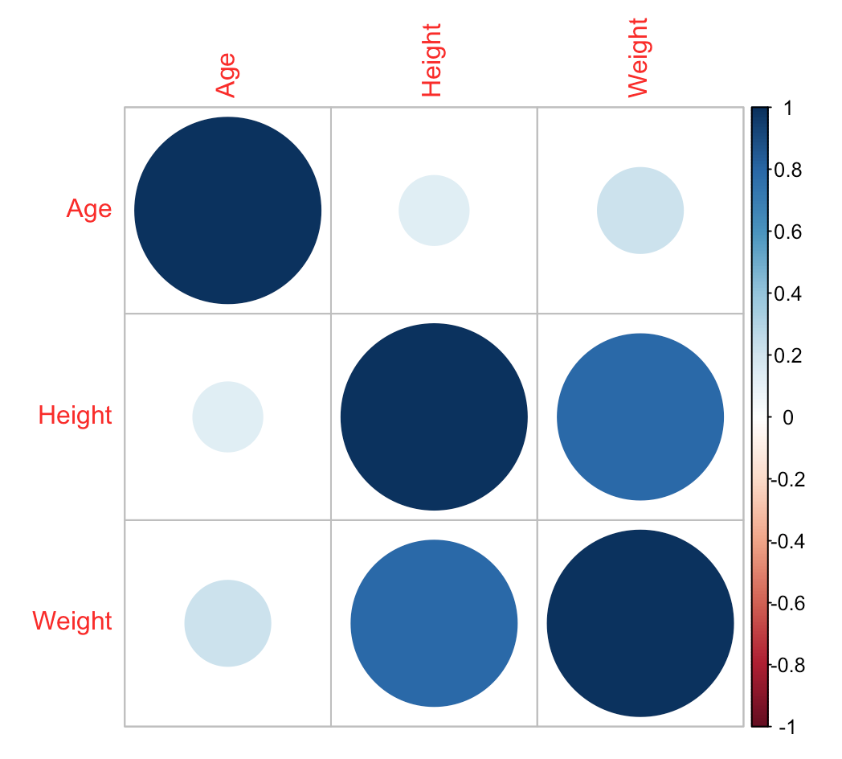
Age, Height, Weight

Slide 12
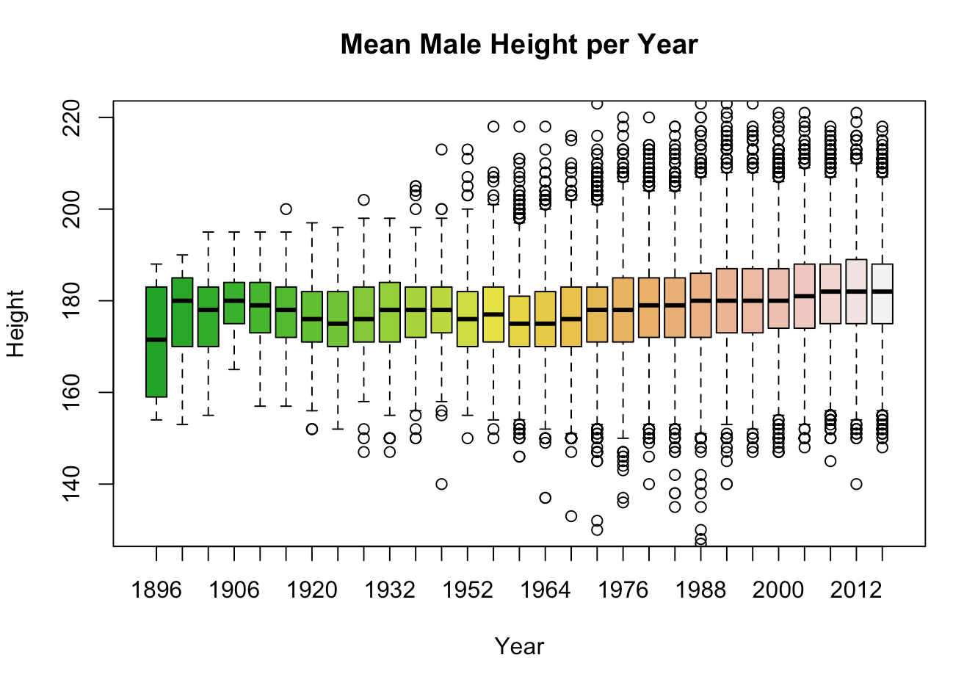
Mean Male Height per Year

Slide 13
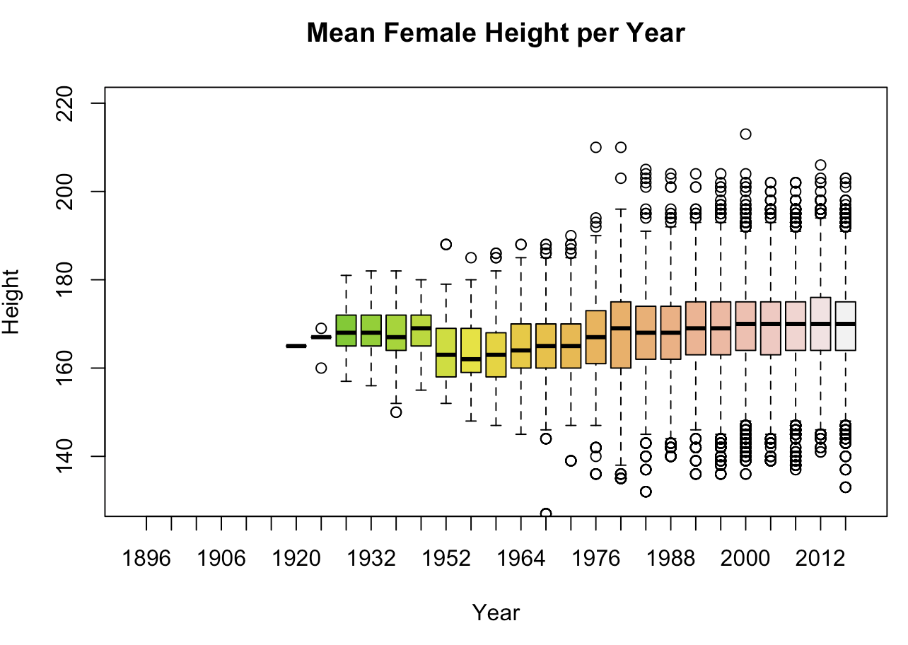
Mean Female Height per Year

Slide 14
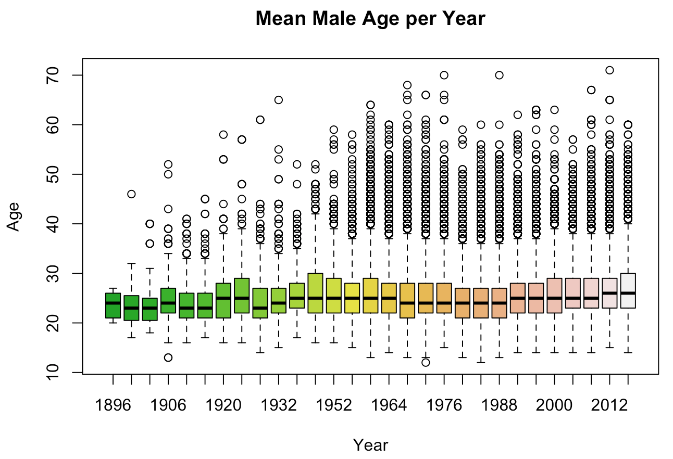
Mean Male Age per Year

Slide 15
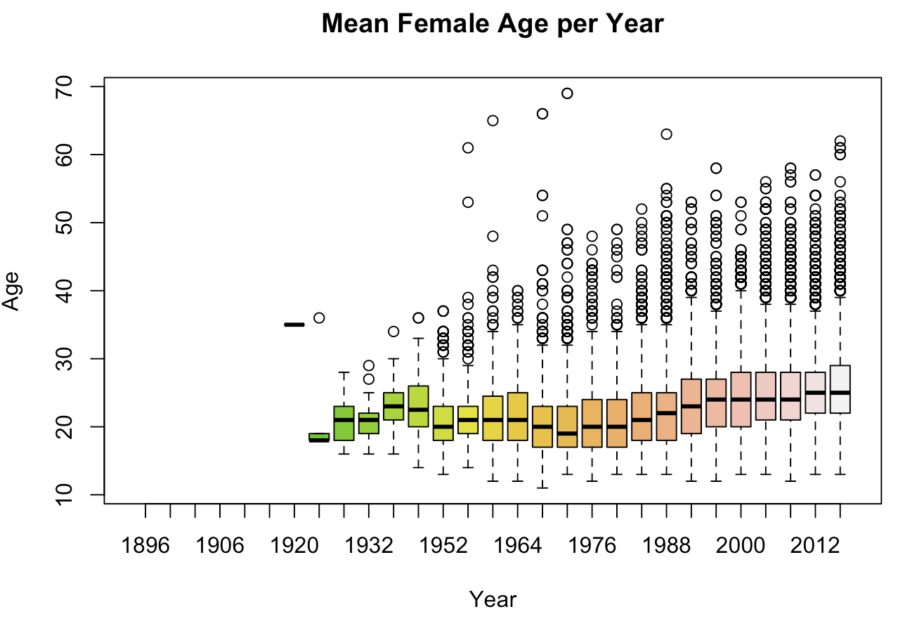
Mean Female Age per Year

Slide 16
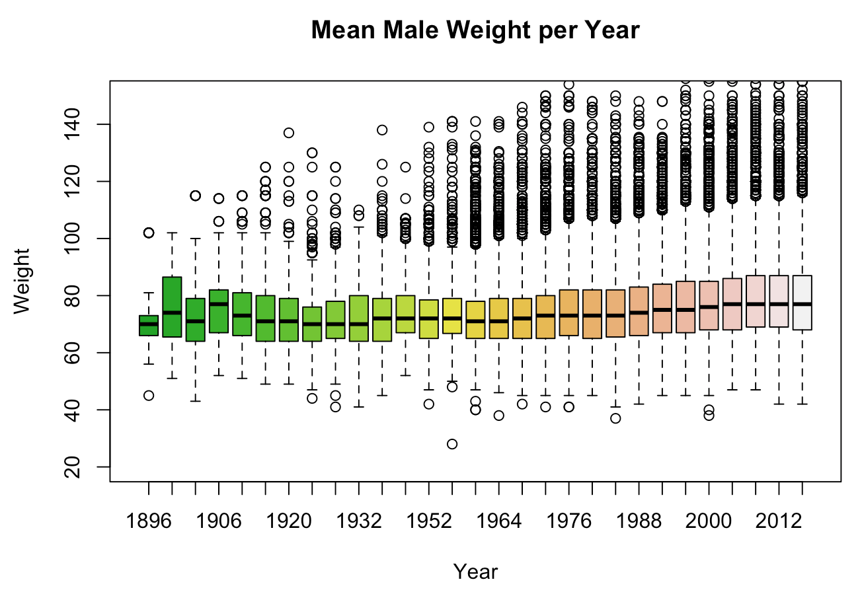
Mean Male Weight per Year

Slide 17
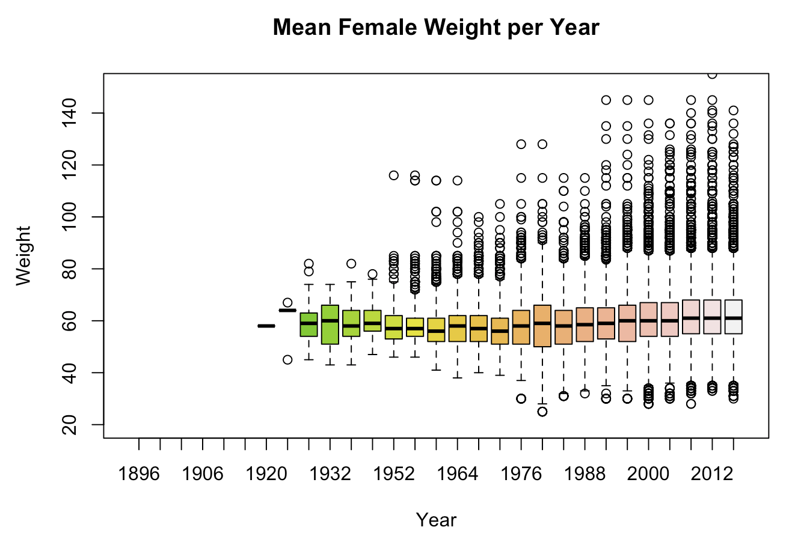
Mean Female Weight per Year

Slide 18
Conclusion
That the number of athletes have been steadily increasing up until 2008 in which we have begun to see a slight decline in participation.
Female participation increasing in recent years while male participation has been declining in the same time period.
The United States is in a comfortable lead for every medal relatively to its competitors. Russia and the USSR follow closely behind while Germany and Australia take 3rd and 4th place respectively in medal count.
Age, height and weight do influence whether an athlete wins a medal or not.

Slide 19
Thank you

